Slide 1
June 1 SPED IDEA Part B
Application
User Guide
FY 2022-23

Slide 2
Changes For 2022-23
Look for changes in the Excess Cost guide to assist with calculating the Average Per Pupil Expenditure (APPE).
Early Childhood section of PSPS sheet form.

Slide 3
June 1 Application
June 1 Applicants include any educational facility receiving IDEA Part B section 611 (School Age) SOF 6702 and/or section 619 (Federal Preschool) SOF 6710, State Preschool SOF 2260 and State EIDT funds SOF 2262.
This includes:
School Districts must complete:
Part I (Signature sheets and Contact Sheet, which is for both School Age and Preschool)
Part II (All four above budgets, PSPS, CCEIS/CEIS and MOE forms. Any equipment or out-of-state forms if needed).
Charters must complete:
Part I (Signature sheets and Contact Sheet, which is for both School Age and Preschool)
Part II (All four above budgets, and the MOE form. Any equipment or out-of-state forms if needed)
State Agencies must complete:
Part I (Signature sheets and Contact Sheet, which is for both School Age and Preschool)
Part II Applicable budgets and the MOE form.
Completing the PSPS, CCEIS/CEIS forms before working the IDEA section 611 excel budget will help keep the required IDEA section 611 total correct.

Slide 4
2022-23
The SPED June 1 IDEA application is located on the DESE Special Education website under Funding and Finance > June 1 IDEA Application.
For the remainder of the year, SPED Finance sets announced deadlines and pulls COGNOS reports for amendments.
SPED Finance uploads approved SPED documents throughout the year into Indistar in the “Uploads from SEA to Districts (SPED)” folder.

Slide 5
Part I: Intent and Assurance Forms
Spring School Board Meetings
The June 1 deadline will require a spring School Board meeting for approval of the application and signature on forms.

Slide 6
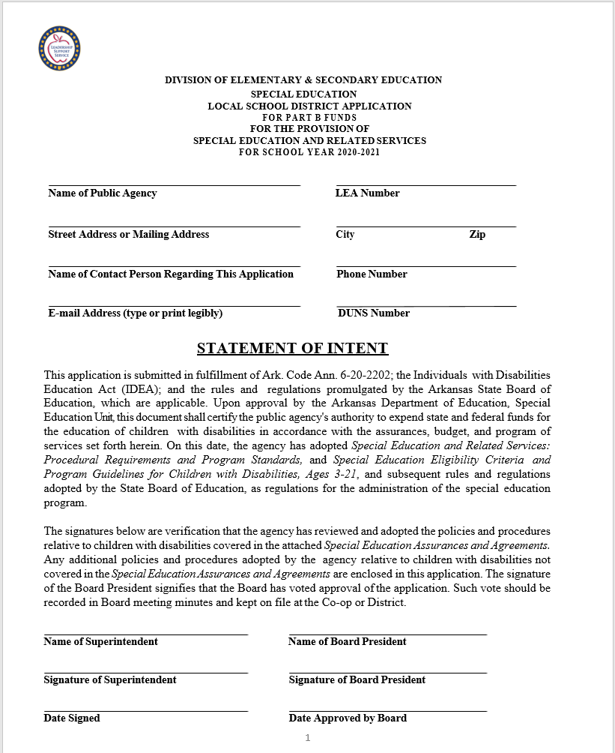
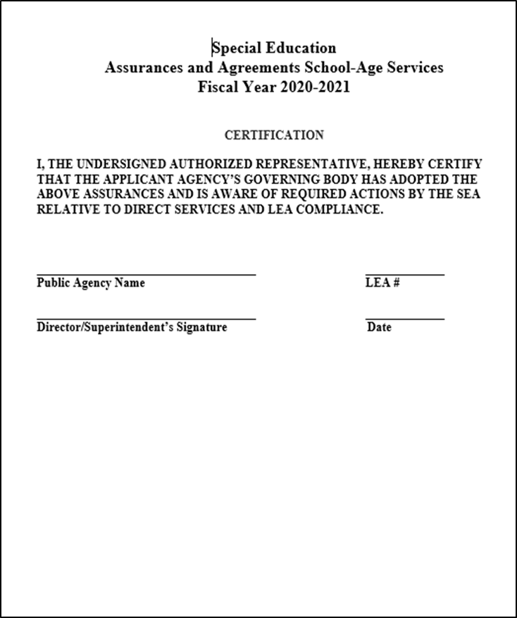
Part I: Intent and Assurance Forms
Ensure the appropriate signatures are obtained.

Slide 7
Contact Information
Please ensure we have the appropriate summer contact information. This will be critical for SPED Finance to contact district staff for corrections during the months of June and July.

Slide 8
Part II School Age Application Forms (EXCEL forms)
Part II contains the following Excel documents and are available on the Special Education website:
Private School Proportionate Share form
CCEIS/CEIS form
MOE form
IDEA School Age Budget Narrative (SOF 6702)
IDEA Preschool Budget Narrative (SOF 6710)
State Preschool Budget Narrative (SOF 2260)
State EIDT Budget Narrative (SOF 2262)
21-22 Report of Equipment
22-23 Request to Purchase Equipment
22-23 Report of Equipment
22-22 Request to Purchase a Bus
22-23 Request for Construction/Renovation
22-23 Request for Travel (Out of State)

Slide 9
June 1 Deadline
The June 1, 20221 Application is for the FY2022-23 IDEA (section 611) School Age, section 619 Federal Preschool, State Preschool and State EITD budgets.
The Application is based on the FY2021-22 Preliminary amount, since FY2022-23 allocations have not yet been announced.
Commissioner’s Memo:
Use the link provided to reach the Allocation page.
https://dese.ade.arkansas.gov/Offices/fiscal-and-administrative-services/school-funding/allocations
IDEA Part B Special Education School Age (SOF 6702) #H027A210018 FIN-22-004
Federal Preschool Special Education (SOF 6710) #H173A200021 FIN-22-004
State Preschool Special Education (SOF 2260) FIN-22-004
State EITD Preschool Special Ed (SOF 2262) FIN-22-004

Slide 10
Importance of Budget Narrative
The Budget Narrative should be a planning budget that reflects what will be spent in the coming year.
The narratives should be clear and detailed.
Use current year expenditures and budget as a guide.
Please do not bundle expenses under one function code. Use appropriate function codes for each item.
Explain in detail all supplies.
Do not use large amounts in supplies unless the intent is to spend this amount. The narrative must explain what will be purchased.
Professional Development Narrative should include the title of the professional development.
Travel should be explained. The out-of-state form should include the title of staff, how many staff, the reason for the travel, and anything pertaining to the travel. Remember out-of-state travel must be preapproved by SPED Finance. A Request Form should be emailed to SPED Finance if out-of-state travel is included in the Budget Narrative.

Slide 11
Budget Narrative
A drop-down list of district names is at the top of each Budget Narrative form for districts to utilize.
All function codes must be explained in the IDEA Part B School Age/Preschool and State Preschool Budget Narrative(s).
For salaries, include the name(s) of staff, Full Time Equivalency (FTE), and position title.
For contracts, list the name of the company and service(s) provided. If the provider is not known, please state in the narrative.
For supplies, list examples. This is particularly important for large purchases.
For equipment (items $5,000 or over), be specific as to the item to be purchased, estimated cost, and location, or put “See Request Form.” Complete the Request Form and email to SPED Finance.
For construction, list a brief general description and complete the Request for Construction Form. Email the completed form to SpEd Finance.
For purchasing a bus, state in the narrative, function 2720/object 67000 and complete the Request to Purchase Bus Form. Email the completed form to SpEd Finance.

Slide 12
Private School Proportionate Share Form All Districts Must Complete
Completing this form before working on the IDEA section 611 excel budget will help to determine if you are required to budget under PSPS.
All districts must complete the PSPS form.
If the district has no Private/Home School students, this will be indicated on line 2 of both the School Age and Early Childhood sections by putting a zero.
When the amounts are correctly entered and calculated, the districts with no Private or Home School students will calculate to zero on line 5 of the School Age and Early Childhood sections.
The total to be budgeted for PSPS in fund 6702 will be under the heading: Total Amount to be budgeted to IDEA Part B 611 (6702) for PSPS.
Please check for accuracy of calculations.

Slide 13
CEIS/CCEIS FORM All Districts Must Complete
Completing this form before working on the IDEA Section 611 excel budget will help to determine if you should include the amount on line #1 in the budget.
For districts required to participate in CCEIS,
please indicate on question #1.
For districts NOT participating in CEIS/CCEIS, please indicate with “NO” on question #2.
For districts participating voluntarily (CEIS), please indicate with a “YES” on question #2.

Slide 14
CEIS/CCEIS Instructions
If participating in Required CCEIS or Voluntary CEIS, the district should have already completed and submitted the 2022-22 CCEIS/CEIS Application by the March 31 deadline.
A district cannot participate in CEIS/CCEIS or use funds pertaining to CEIS/CCEIS until a program application has been approved by the DESE Special Education Unit.

Slide 15
CEIS/CCEIS Amount
Refer to the following link for the FY2021-22 CEIS/CCEIS amount to use of the June 1 Application.
FY2122-CCEIS-Prelim-Chart.pdf (arkansas.gov)

Slide 16
MOE Eligibility Requirement Form All Districts, Charters, and State Agencies Must Complete
Complete the Eligibility Requirement as a promise to meet Maintenance of Effort and an intent to spend at least the amount spent in the last completed year (FY2020-21 AFR).
Choose one MOE test to complete, showing how the district intends to meet Maintenance of Effort for FY2022-23.

Slide 17
MOE Instructions
If choosing Local Plus State as the test to complete for MOE, use the FY2020-21 State/Local AFR expenditure amount available in COGNOS and enter into line # 2.
Districts received the FY2020-21 AFR reports with the approved October 1 IDEA Budget Amendment. The FY2020-21 AFR MOE Data Form in MYSPED should also have the correct amount for the FY2020-21 AFR.
The projected amount for FY2022-23 must be equal to or more than the amount in line # 2.
Districts may enter the same amount as the FY2020-21 State/Local AFR or enter an amount that is more.

Slide 18
Sample Budget Narrative
July 1, 2022-June 30,2023
FY21-22
Narrative goes directly under the amount.

Slide 19
Preschool Services
Districts must complete the preschool excel budget regardless of who is providing the service. The district is the responsible fiscal agent.
Districts that are contracting with Co-ops to provide EC services will be responsible for the budget of State and Federal Preschool funds being provided to the Co-op as Function 1290, Object Code 65910 (Preschool-Purchase Services) titled as “Early Childhood services provided by Name of Co-op.”
Districts that operate their own EC programs will not change budgeting procedures.
Co-ops will not be expected to provide State or Federal Preschool Budgets to DESE.
Charters receiving preschool funds for 5 yr. olds in Kindergarten must complete a preschool excel budget.

Slide 20
Preschool Budget Narrative if CO-OP Provides the Services
Co-ops will not provide State or Federal Preschool Budgets to DESE

Slide 21
Request for Equipment
Equipment (any item over $5,000) must be preapproved before purchasing.
The equipment amount must be included in the budget before approval can be given.
Items over $1,000 to $4,999.99 still need to be budgeted as equipment, but no request form is required.

Slide 22
Report of Equipment
Please send the Report of Equipment Form to SPED Finance once equipment purchases are made and the exact expenditure amount is known.
The information on the form should match the function and amount of the AFR report.

Slide 23
Request for Bus Purchase
Before purchasing a bus, districts must submit a signed Request Form along with bus specifications.
SPED Finance will forward the Request and bus specifications to the Transportation Unit for approval.
The bus estimate must be in the budget before approval can be given.

Slide 24
Request for Out-Of-State Travel
Federal guidance requires prior approval for out-of-state travel.
Please ensure the funding for the travel is in the budget and fill in the funding chart on the Request Form.
Email the completed form to SPED Finance.

Slide 25
Request for Construction/Renovation
Construction/Renovation must be preapproved and requires a Request Form.
If the project is $20,000 or more, specifications will need to be provided and SPED Finance will forward the Request with specifications to the Facilities Unit for approval.
All Construction/Renovation must be in the budget before approval can be given.
Function codes 4710 and 4720 should be used with object code range 64000.

Slide 26
Email all June 1 Application files for Part I and II
along with Excess Cost Worksheets to:
spedfinance.indistar@ade.arkansas.gov
The subject line of the email should include the LEA# and Name of District, Charter or State Agency.
The file names will be:
SPED2023 Part I and II
****
Please only send signature and contact sheet pages for Part 1
Please remember to send Part II in excel format
****
PLEASE SEND ALL PARTS IN ONE EMAIL

Slide 27
Correctional Comments
Correctional correspondence will be sent from the SPED Finance team through their ade.arkansas.gov email.
The Sped Finance team will not be responding to you through Indistar. All reviews will come via email or phone call.

Slide 28
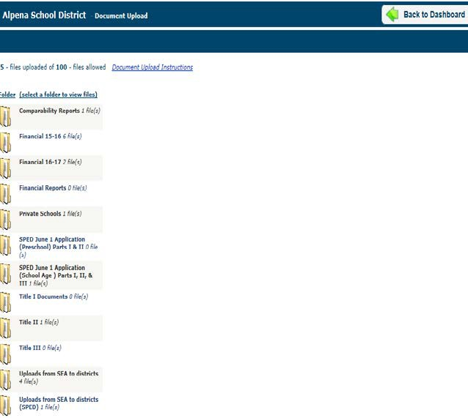
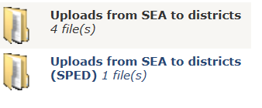
Approved Application
When an application or amendment is approved by SPED Finance, the approved forms are uploaded into Indistar in the “Uploads from SEA to Districts (SPED)” folder.
This folder is for State use only. Please do not delete or add anything to this folder.

Slide 29
Contact Information
SPED Finance team | Phone | Email
Josh Hart | 501-682-4294 | josh.hart@ade.arkansas.gov
Mikki Eubank | 501-682-4293 | mikki.eubank@ade.arkansas.gov
Kim Vogt | 501-682-4295 | kim.vogt@ade.arkansas.gov
Patricia Siribouth | 501-683-3449 | patricia.siribouth@ade.arkansas.gov
Audrey Chandler | 501-683-5869 | audrey.chandler@ade.arkansas.gov

